Slide 1

Student Management System
Presented by
Kiran Harischandra More &
Devang Vijay Bhuvad

Slide 2

Abstract
• Overview:-
The Student Management System automates the registration and management of student records

Slide 3

Key Features
• Unique ID generation for each student
• Data protection for personal use, ensuring efficient data processing

Slide 4

Introduction

Slide 5
• Objective
• Transition from manual to computerized processes to save time and costs
• Efficient management of student records

Slide 6

• Scope
• Applicable in schools, colleges, and coaching institutes

Slide 7

Hardware Requirements

Slide 8

Minimum Specifications
• Pentium 4 processor or higher
• 128 MB RAM or above
• 40 GB hard disk space
• Mouse and keyboard

Slide 9

Software Requirements
• Operating Systems: Windows 8/9/10/11
• Development Tools:
• Python Interpreter
• Visual Studio Code
• XAMPP or MySQL Workbench for database management

Slide 10
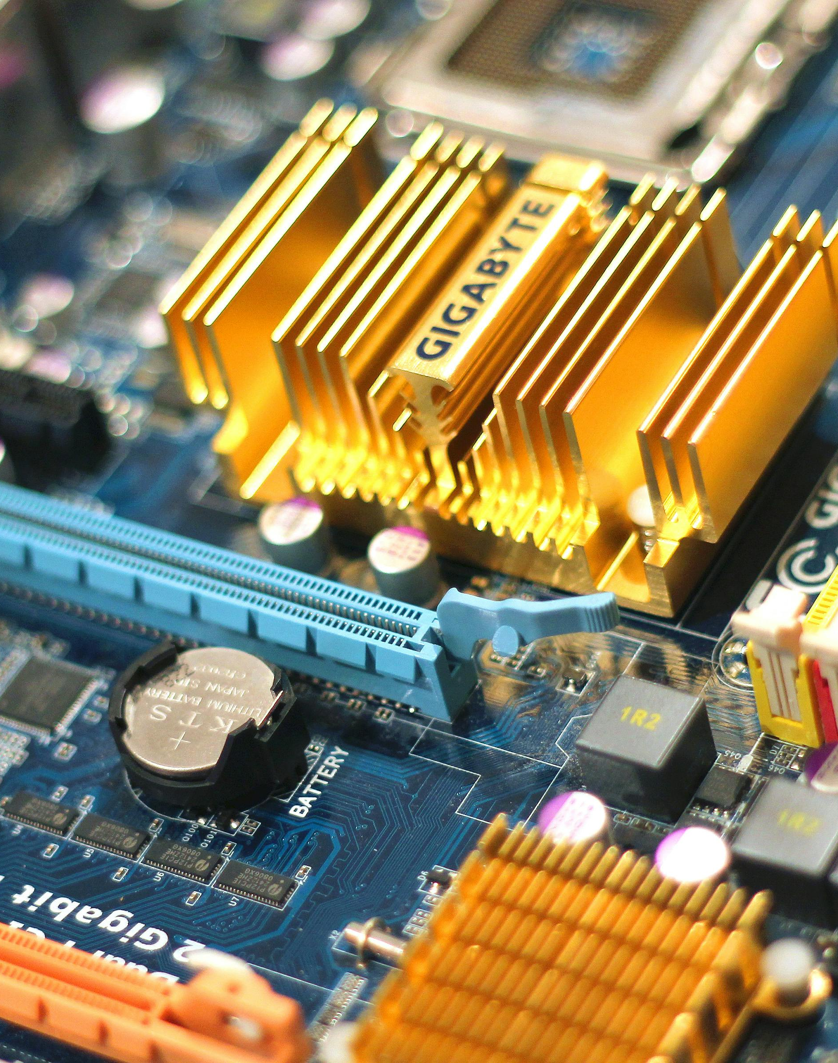
Technical Description
• Programming Language: Python
• High-level, general-purpose language
known for readability and efficiency.
• GUI Toolkit: Tkinter
• Standard interface for creating graphical
user interfaces in Python.

Slide 11
Diagram:-

Slide 12
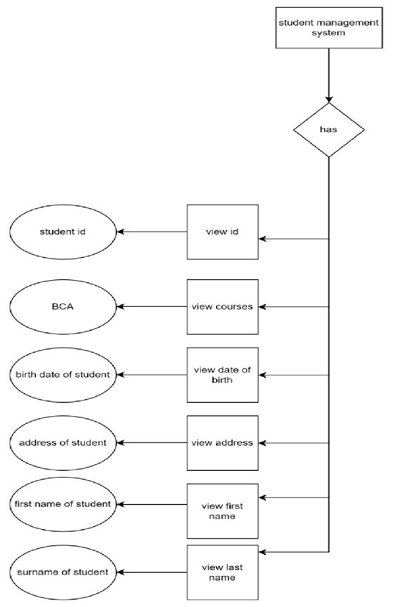
ER Diagram:-

Slide 13
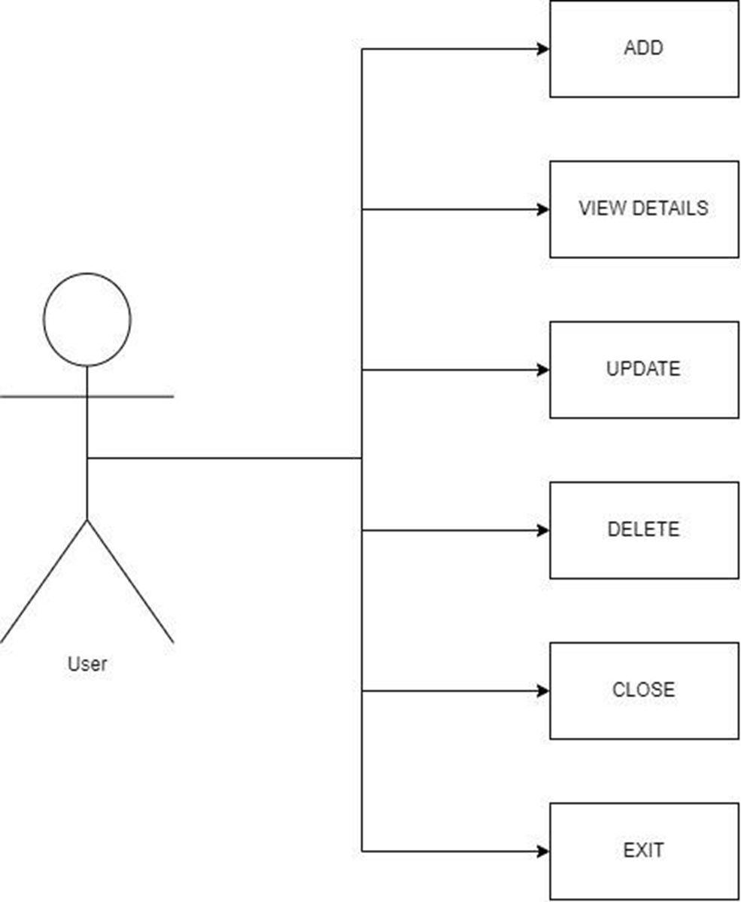
Use Diagram:-

Slide 14
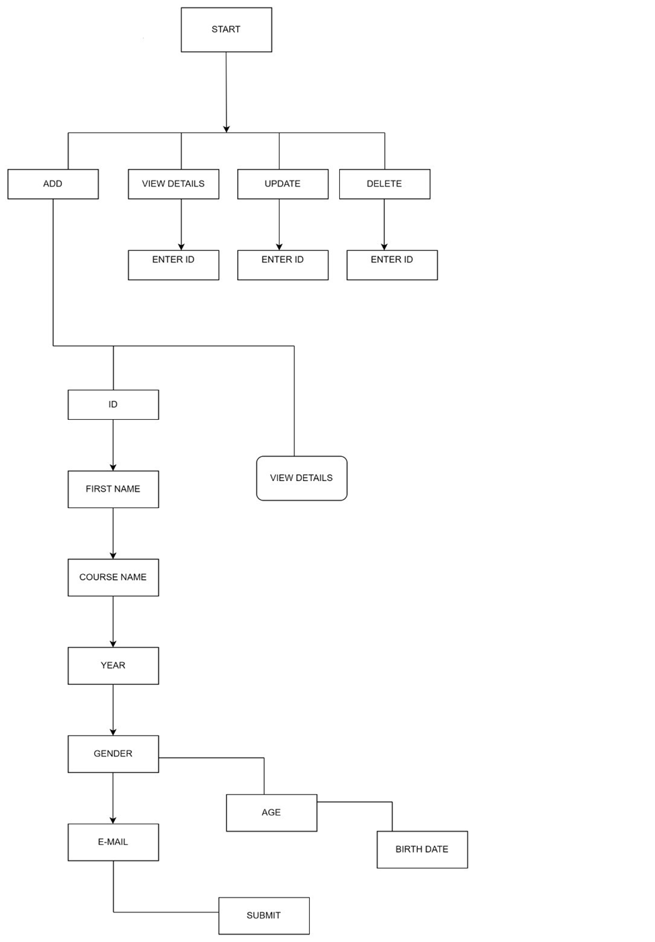
Flow Chart:-

Slide 15
Snapshots:-

Slide 16
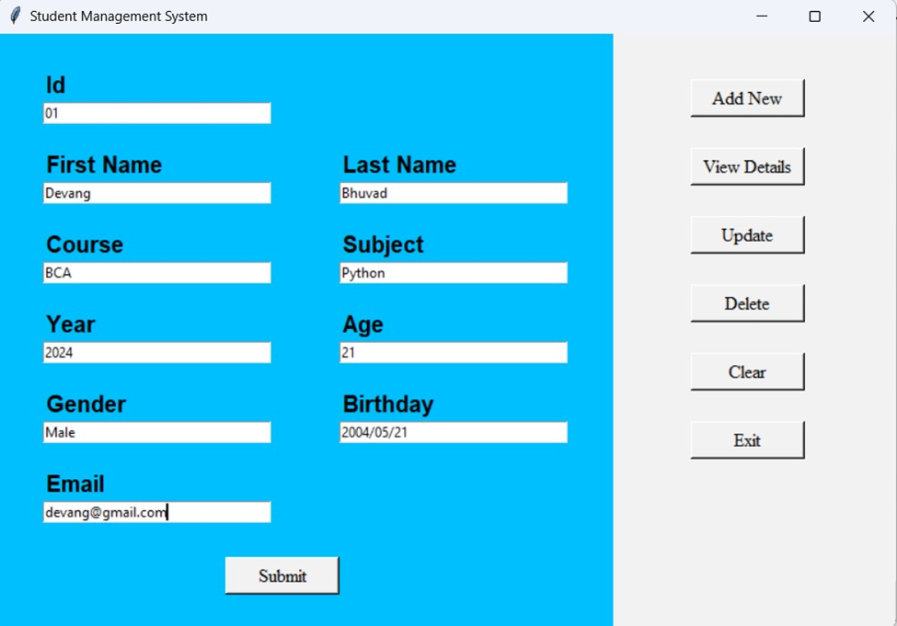
Add New Details:

Slide 17
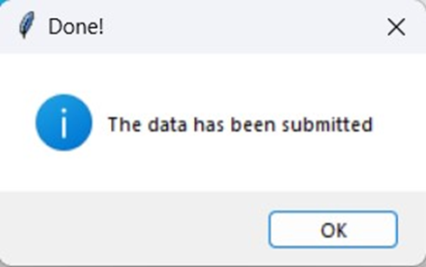
After Submitting Details :

Slide 18
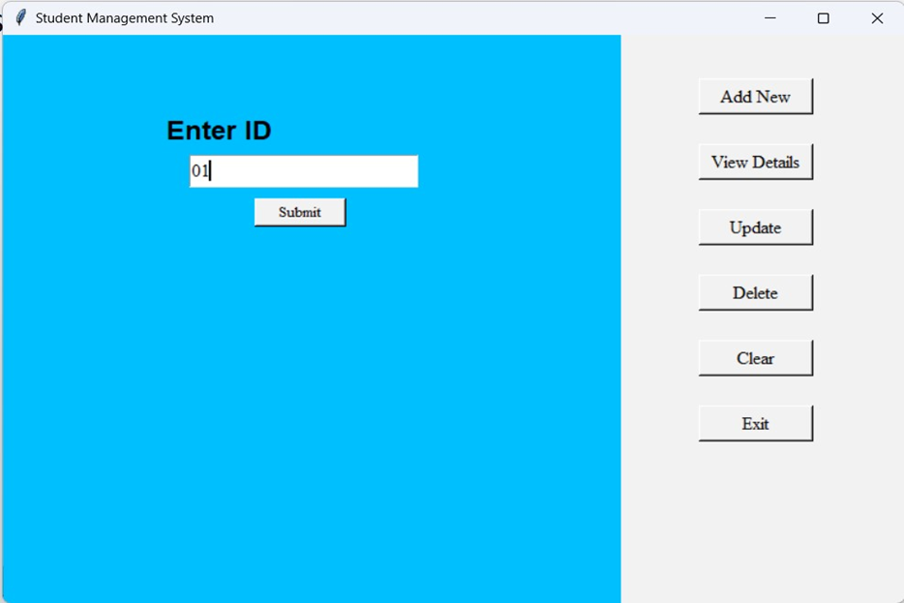
View Details:

Slide 19
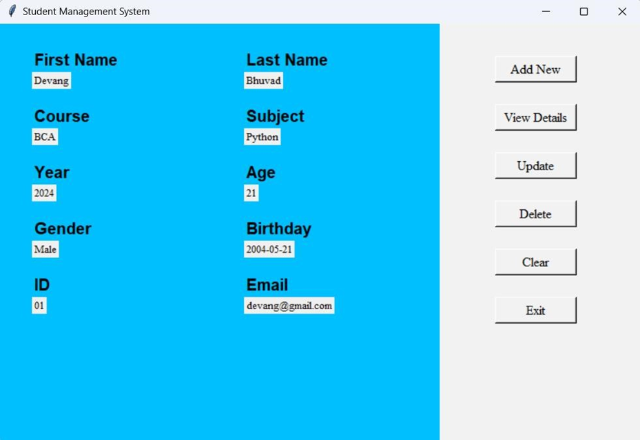

Slide 20
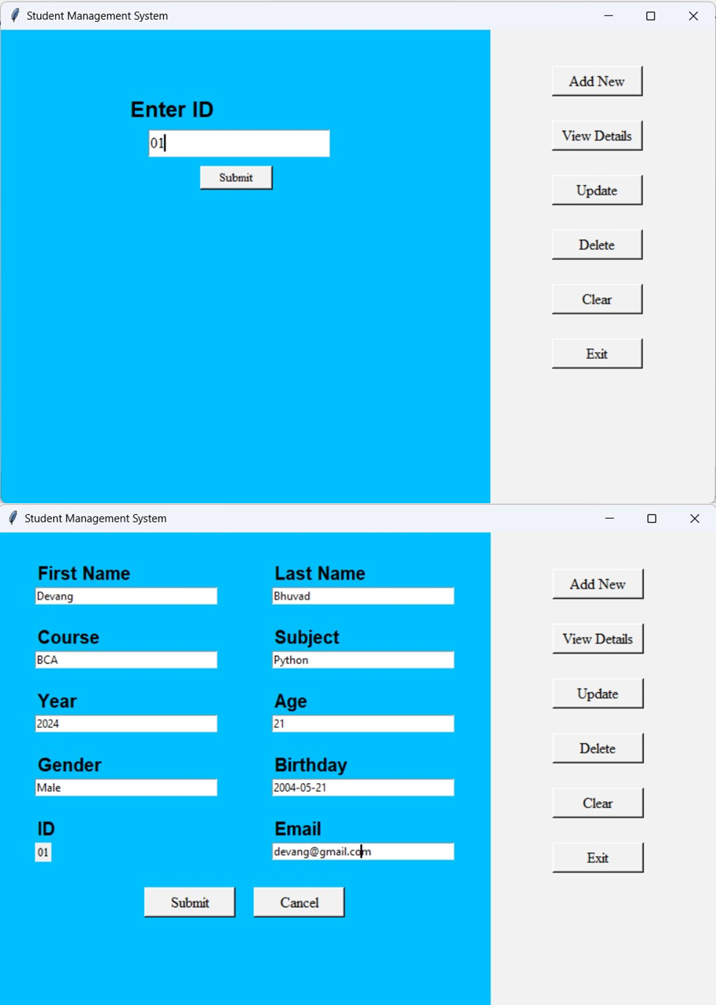
Update Details

Slide 22
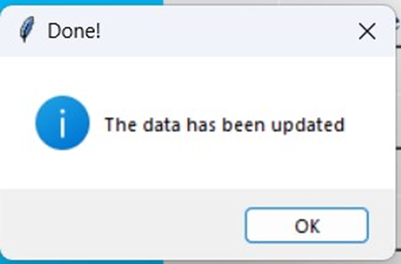
After Update Details:

Slide 23

Delete Details:

Slide 24
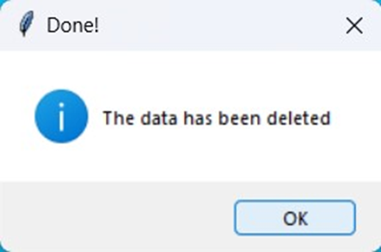
After Delete Details:

Slide 25

Key Features of the System
• User Functions:
Add, view, update, delete student records.
• Data Handling:
Input fields for student details (name, course, contact).
• Error Handling:
User-friendly error messages for input validation.

Slide 26
Conclusion
• The Student Management System streamlines the management of student records through automation
• Enhances efficiency and accuracy while providing a user-friendly experience

Slide 27

Questions?
• Open floor for any questions from the audience

Slide 28
THANK YOU

